Slide 1
Programming Fundamentals
Course Code: CS-111
Course Instructor: Isra Naz

Slide 2

Quiz 2
In Progress

Slide 3

CLO Covered in this Lecture:
CLO2 - Applies basic programming concepts through hands-on experience with C++ syntax and structure.

Slide 4
Goal for today:
Iteration statement
For Loop

Slide 5
Try it your self
Write a program that gets starting and ending point from the user and displays all odd numbers in the given range using do-while loop and your output must be look like the following
Output
Enter starting number: 5
Enter ending number: 15
5
7
9
11
13
15

Slide 6
Try it your self
Write a program that gets two numbers from the user and displays the result of first number raise to the power of second number using do-while loop.
Output
Enter first number 2
Enter second number 3
Result is 8

Slide 7
‘Continue’ Statement
When continue statement is used inside the body of the loop it shifts the control to the start of the loop body.
When this statement is executed in the loop body, the remaining statements of current iteration are not executed.
The control directly moves to the next iteration.
Syntax
continue;

Slide 8
Example
int x;
for (x = 1; x<=5; x++)
{
cout<<“Hello World”<<endl;
continue;
cout<<“Knowledge is power.”;
}

Slide 9
Example
A program that displays the sum of the following series:
1+3+5+7+…+100
Output:
The sum is 2500

Slide 10
Example
A program that displays the sum of the following series:
1+3+5+7+…+100
{
int sum=0;
for(int i=1;i<=100;i++)
{
if(i%2 == 0)
continue;
sum = sum + i;
cout<<sum<<endl;
}
cout<<"The sum is"<<sum;
}

Slide 11
‘break’ Statement
Terminates the execution of loop, when used inside the body of the loop.
Other statements after the break are not executed.
The control directly moves outside the body and the statement that comes after the body is executed.
Syntax
break;

Slide 12
Example
for(int x = 1; x<=5; x++)
{
cout<<"Questioning"<<endl;
break;
cout<<"Gateway to knowledge";
}
cout<<"Bye";

Slide 13
‘For’ Loop
For loop executes one or more statements for a specified number of times.
This loop is also called counter-controlled loop.
It’s usually (although not always) used when you know, before entering the loop, how many times you want to execute the code.
It consists of three parts:
Initialization (optional)
Test condition
Increment/decrement expression (optional)

Slide 14

Single Statement Loop
for( initialization expr; condition; increment/decr) statement;
Multi Statement Loop
for(initialization expr; condition; increment/decr)
{
statement1; statement2;
}

Slide 15

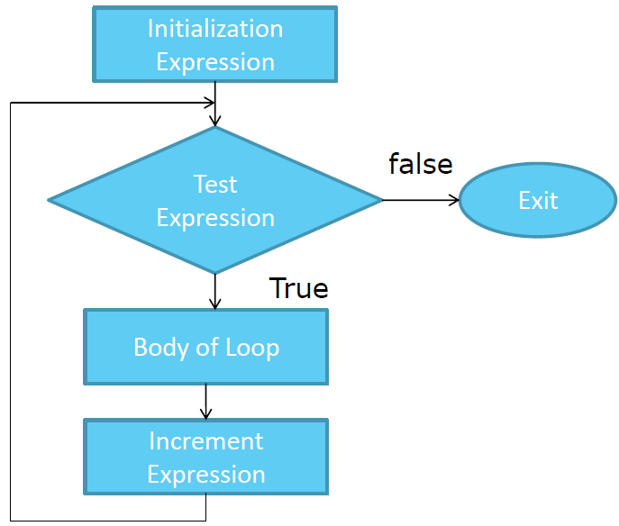

Slide 16
 Initialization expr
In this part, the loop variable (or variables) is initialized. The variable is already declared. If not then it may be declared and initialized within this part of loop, e.g.,
for (a=1 ; a<3 ; a++)
for (int a=1, b = 5; a<10; a++)
The initialization part of loop is optional. If this part is omitted, then a semicolon is used in its place.
for ( ; a<10; a++)
Notes:
One or many variables can be initialized in this part. To initialize many variables, each variable is separated by comma.
The initialization expression is executed only once, when the loop first starts.

Slide 17
 Condition
In this part, the test condition is given. The body of the loop is executed only if the test condition evaluates to true.
Increment/decrement
In this part, the loop variable(s) is incremented or decremented.
To increment or decrement more than one variable, they are written comma separated.
This part is executed after executing loop body.
This part is also optional. If this part is not used then loop variable must be incremented/decremented inside loop body.
for (; a<10;)

Slide 18
Example
Program that displays counting from 1 to 5 using for loop

Slide 19
Example
Program that displays counting from 1 to 5 using for loop
int main()
{
int n;
for (n=1; n<=5; n++)
cout<<n<<endl;
return 0;
}

Slide 20
Example
Product of all odd numbers from 1 to 10
Output:
Result is 945

Slide 21
Example Find Output
int main()
{
int product = 1;
int c;
for( c=1; c<=10; c = c+2)
product *=c;
cout<<“Result is”<<product;
}

Slide 22
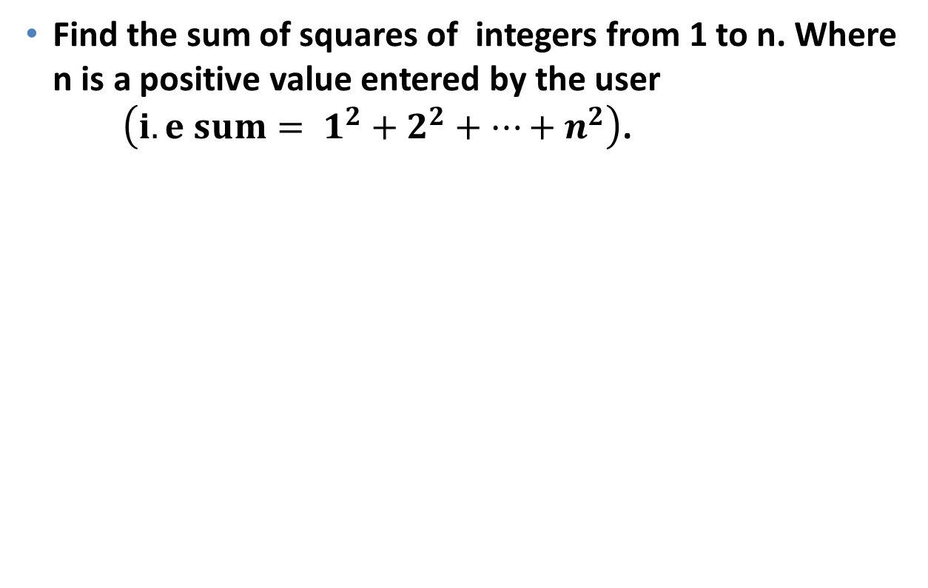
Example
Find the sum of squares of integers from 1 to n. Where n is a positive value entered by the user $\left({i.e sum= 1}^{2}+2^{2}+…+n^{2}\right)$.
Output:
Enter a number: 5
Sum of squares is 55

Slide 23
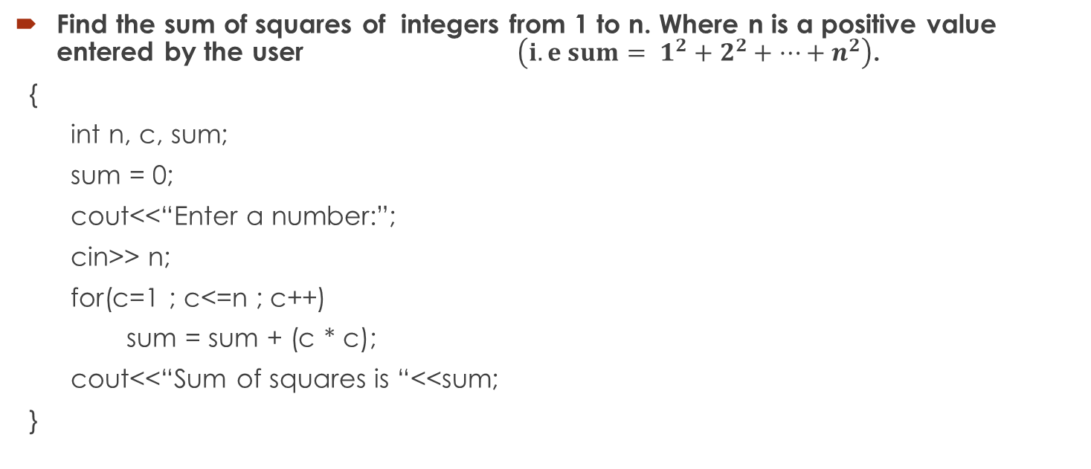
Example
Find the sum of squares of integers from 1 to n. Where n is a positive value entered by the user $\left({i.e sum= 1}^{2}+2^{2}+…+n^{2}\right)$.
{
int n, c, sum;
sum = 0;
cout<<“Enter a number:”;
cin>> n;
for(c=1 ; c<=n ; c++)
sum = sum + (c * c);
cout<<“Sum of squares is “<<sum;
}
Output:
Enter a number: 5
Sum of squares is 55

Slide 24
// countdown using a for loop
#include <iostream>
int main ()
{
for (int n=1; n<=10; n++)
{
cout << n << endl;
}
cout << “pakistan";
return 0;
}
Output:
?

Slide 25
Example
Program to print the following series:
1 4 7 10 … 40

Slide 26
Example
Program to print the following series:
1 4 7 10 … 40
{
int a = 1, i , incre = 3;
cout<< “ The series is as follows:”;
for (i = 1 ; a<=40; i++)
{
cout<<a<<“/t”;
a = a + incre;
}
}

Slide 27
Example
A program that inputs a number and checks whether it is a perfect number or not. A perfect number is a number that is numerically equal to the sum of its divisors.
For example, 6 is a perfect number because the divisors of 6 are 1, 2, 3 and 1 + 2 + 3 = 6.

Slide 28
Example
{
int i, num, mid, sum =0;
cout<<“Enter the number:”;
cin>>num;
mid = num/2;
for(i = 1; i<=mid; i++)
{
if((num%i) = = 0)
sum = sum + I;
}
if(sum = = num)
cout<<num<<“is a perfect number”;
else
cout<<num<<“is not a perfect number”;
}

Slide 29
Example
A program that inputs an integer and prints if it is prime or composite.

Slide 30
Example
A program that inputs an integer and prints if it is prime or composite.
{
int c, num, p = 1;
cout<<“Enter an integer:”;
cin>>num;
for (c=2;c<=num/2; c++)
if(num%c == 0)
{
p=0;
break;
}
if(p==1)
cout<<num<<“is a prime number.”;
else
cout<<num<<“is a composite number.”;
}

Slide 31
Nested Loops
A loop within a loop is called as nested loop.
In nested loops, the inner loop is executed completely with each change in the value of counter variable of outer loop.
Any loop can be used as inner loop of another loop.
For example, while loop can be used as outer loop for loop can be used as inner loop in nested loop.

Slide 32
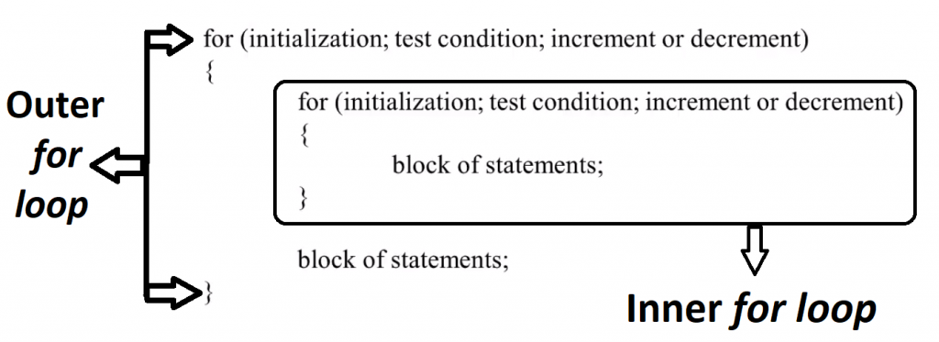
Syntax

Slide 33
Example
Output:
Outer loop: 1 Inner loop: 1
Outer loop: 1 Inner loop: 2
Outer loop: 1 Inner loop: 3
Outer loop: 2 Inner loop: 1
Outer loop: 2 Inner loop: 2
Outer loop: 2 Inner loop: 3
int i, j;
for (i=1; i<=2; i++)
for (j=1; j<=3; j++)
cout<<“Outer loop:”<<i<<“Inner loop:”<<j<<endl;

Slide 34
Example
Output:
Outer loop: 1 Inner loop: 1
Outer loop: 1 Inner loop: 2
Outer loop: 1 Inner loop: 3
Outer loop: 2 Inner loop: 1
Outer loop: 2 Inner loop: 2
Outer loop: 2 Inner loop: 3
int i,j;
i=1;
while(i<=2)
{
j=1;
while(j<=3)
{
cout<<"Outer Loop:"<<i<<"Inner Loop:"<<j<<endl;
j++;
}
}
i++;

Slide 35
Example
A program that displays the following output
1 = 1
1 + 2 = 3
1 + 2 + 3 = 6
1 + 2 + 3 + 4 = 10
1 + 2 + 3 + 4 + 5 = 15

Slide 36
Example
int i,j,sum;
for(i=1;i<=5;i++)
{
cout<<"1";
sum = 1;
for(j=2;j<=i;j++)
{
cout<<"+"<<j;
sum = sum + j;
}
cout<<"="<<sum<<endl;
}

Slide 37
Example
A program that inputs the height of triangle and displays a triangle of characters. For example, if user enters 5, it displays the following
Enter the height of triangle: 5
A
B C
D E F
G H I J
K L M N O

Slide 38
Example
{
char ch = 'A';
int n, i , j;
cout<<"Enter the height of triangle:";
cin>>n;
for(i=1;i<=n;i++)
{
for(j=1;j<=i;j++)
{
cout<<ch<<" ";
ch++;
}
cout<<endl;
}
}

Slide 39
Example
Write a program that inputs the height of a triangle and displays it using loop. For example, if the user enters height as 5, the program should print the following
& & & & & & & & &
& & & & & & &
& & & & &
& & &
&

Slide 40
Example
Output
Enter height of a triangle: 5
& & & & & & & & &
& & & & & & &
& & & & &
& & &
&
int n, i, j,sp;
cout<<"Enter height of a triangle:";
cin>>n;
for(i=n;i>0;i--)
{
for(sp=0; sp<=n-i;sp++)
cout<<" "<<" ";
for (j=1;j<=2*i-1;j++)
cout<<"&"<<" ";
cout<<endl;
}

Slide 41
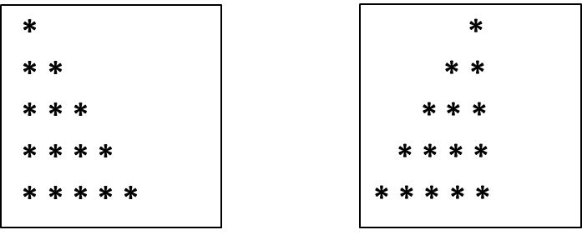
Practice Questions
Write a program that displays the following pattern using nested for loop

Slide 42


